Slide 1
A Hybrid Deep Learning Framework for Traffic Sign Recognition using Model Fusion
Submitted By:
221FA04266
221FA04678
Guide: M. Bhargavi Mam

Slide 2
ABSTRACT
The technology of Automatic Traffic Sign Recog nition (ATSR) plays an important role in autonomous driving including Advanced Driver Assistance Systems (ADAS) as well as improving road safety. There have been major advancements on this technology through the use of Convolutional Neural Networks (CNN), but there are still several challenges that exist, such as class imbalance, varying scale, and complexity of driving scenarios. The research presented in this paper outlines a framework designed for recognizing traffic signs utilizing the LISA dataset. To extract Regions of Interest (ROIs), image background noise is removed by extracting bounding boxes, then the resulting ROIs are resized, augmented through data aug mentation and class-balanced for generalizability. The proposed framework utilizes multiple CNN architectures such as ResNet18, ResNet50, EfficientNet-B0, and DenseNet121 for classification in addition to the use of multiple fusion methods like average and attention-based fusion to improve performance. Experimental results indicate that the proposed system achieved an overall accuracy of 98% while individual model performance was also improved through the use of fusions.

Slide 3
INTRODUCTION
Traffic sign recognition (TSR) systems are a key aspect of intelligent transport systems (ITS), ADAS, autonomous driving and improve road safety. By successfully detecting and interpreting the traffic signs around them, vehicles use TSR systems to make safe and correct driving decisions in the real world. TSR systems are at risk of facing many hurdles in real-world scenarios, including variations in illumination, occlusions, background clutter, scale changes and class imbalance. Over the last few years, CNNs and deep learning have become the dominant methods used for TSR primary due to their ability to automatically learn multiple representations of higher and lower level features from the input image without having to be explicitly told what feature, or features, each traffic sign contains [6]. Several types of CNN architectures have been used extensively for traffic sign classification, including ResNet [5], DenseNet [8] and MobileNet [9], and have demonstrated strong and reliable performance. More recently, the advent of EfficientNet [7] has provided researchers with improved accuracy and efficiency for traffic sign classification by scaling the network’s depth, width and resolution through a process too complex for most researchers to achieve without implementing a model scaling method.

Slide 4
While there have been many advancements made in terms of algorithms and architecture for traffic sign recognition, it is not uncommon for single-model methods to show signs of insufficient generalization capability especially when comparing similar traffic signs visually like STOP and YIELD, or when utilizing imbalanced datasets in the training phase. The aforementioned limitations will subsequently result in the need for the use of more robust methods to properly represent the diverse feature space of each traffic sign.

Slide 5
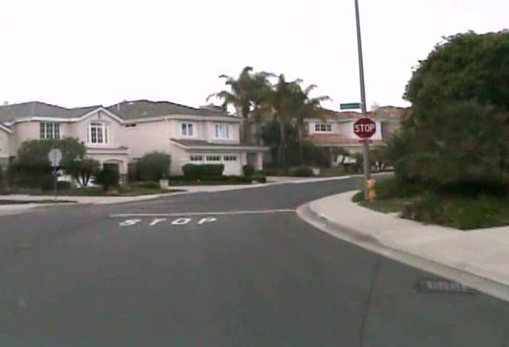
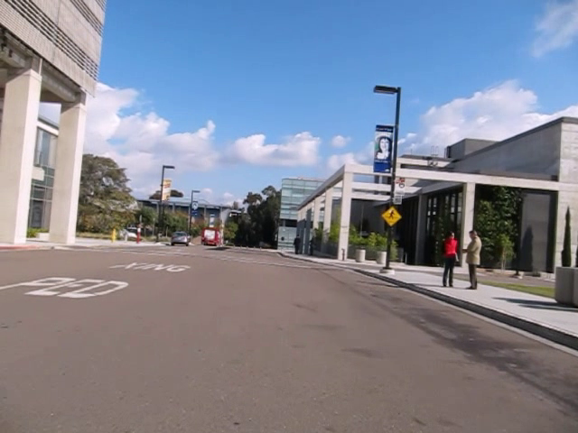
DATASET
Link: https://www.kaggle.com/datasets/mmontiel/tiny-lisa-traffic-sign-detection-dataset

Slide 6
Key Characteristics
Total Images: Approximately 900 images.
Object Classes: 9 traffic sign classes.
Annotation Format: There is an annotations CSV file containing bounding box coordinates and class labels for each image.
The dataset is a subset of the original LISA dataset, which in full form has 6,610 images and 47 classes, but Tiny LISA is reduced for simpler and faster model experimentation.
Dataset Structure :
db_lisa_tiny/
├── annotations.csv
├── sample_001.png
├── sample_002.png
...
├── sample_900.png

Slide 7
Tools and Technologies Used:
1. Programming Language – Python
2. Deep Learning Framework – PyTorch
3. Pretrained Model Library – Torchvision
4. Torchvision was used to access pretrained models and standard datasets. The following architectures were implemented using pretrained weights:
ResNet18
ResNet50
EfficientNet-B0
DenseNet121
5. Visualization Tools - Matplotlib – Performance visualization
6. Development Environment - Kaggle Notebook

Slide 8
LITERATURE REVIEW
Reference No | Year | Proposed Model | Advantages | Limitations
1 | 2025 | NanoVerse YOLO + Vision-Language Contrastive Learning | Improved small sign detection and long-tail class handling | Complex architecture, higher computational cost
2 | 2024 | Optimized CNN (GTSRB) | High accuracy with simple architecture | Limited real-world robustness
3 | 2024 | Vision Transformer based models | Captures global context and multi-scale features | High computational requirements
4 | 2024 | YOLO Systematic Review | Summarizes real-time detection strengths | No novel model contribution
5 | 2025 | YOLOv5 with optimized anchors | Improved small object detection | Performance drops in cluttered scenes
6 | 2025 | YOLO-BS (YOLOv8 variant) | Strong dataset-specific performance | Limited cross-dataset generalization
7 | 2024 | TrafficSignNet (CNN) | High classification accuracy | Detection capability limited
8 | 2023 | Efficient Vision Transformer | Improved feature extraction | Transformer overhead
9 | 2024 | CNN/ResNet/VGG/EfficientNet comparison | Comprehensive performance analysis | Focus on classification only

Slide 9
10 | 2023 | Improved YOLOv4-tiny | Reduced parameters, faster inference | Lower accuracy than newer YOLO models
11 | 2025 | DP-YOLO (YOLOv8 variant) | Lightweight, edge-device friendly | Complex integration
12 | 2024 | TSD-YOLO with SPD module | Enhanced small-object detection | Increased training complexity
13 | 2025 | YOLO-LLTS (Low-light) | Robust low-light detection | Limited to low-light scenarios
14 | 2024 | YOLO-CCA (Context-based YOLOv7) | Better context awareness | Dependent on older YOLO version
15 | 2024 | EMDFNet | Strong multi-scale feature fusion | Higher computational cost
16 | 2025 | Two-phase YOLOv8 + CNN | High detection and classification accuracy | Pipeline complexity
17 | 2025 | YOLO-based Survey | Comprehensive overview | No experimental contribution
18 | 2023 | Improved YOLOv4-tiny (OctConv) | Lightweight and fast | Lower accuracy
19 | 2022 | Faster R-CNN | Robust detection accuracy | Slow inference
20 | 2024 | Improved Faster R-CNN | Better small sign detection | High computational cost

Slide 10
22 | 2023 | Improved YOLOv5 multi-scale | Enhanced detection accuracy | More parameters
23 | 2023 | Improved YOLOv8 on CCTSDB | Reduced missed detections | Generalization unclear
24 | 2025 | Efficient ViT Hybrid | Global and local feature learning | Heavy model
25 | 2024 | YOLO-CCA (ArXiv) | Improved fusion efficiency | Architecture dependency

Slide 11
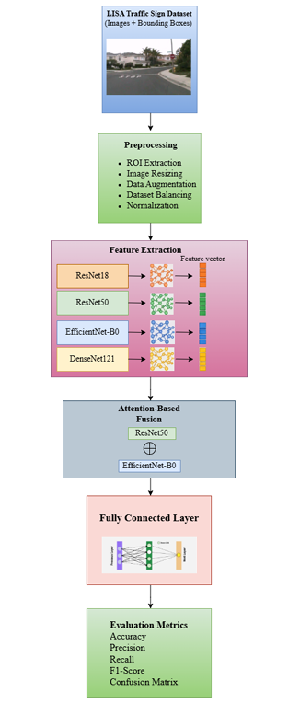
METHODOLOGY
Fig. Workflow

Slide 12
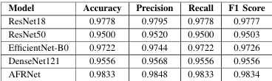
PERFORMANCE ANALYSIS:
Table 1. Performance comparison of individual and proposed fusion

Slide 13
TableI summarizes each model’s accuracy results. ResNet18 achieved the highest accuracy of all models with 97.78%, closely followed by EfficientNet-B0 which achieved an ac curacy of 97.22%. Both models perform very well at success fully extracting relevant features related to traffic signs and identifying them correctly due to their designs. EfficientNet is uniformly scaled which allows it to achieve a balance between efficient processing and design, whereas ResNet18 utilizes residual connections within its architecture for continual stable learning. DenseNet121 achieved an accuracy of 95.56% which indicates it is able to efficiently reuse features; however, ResNet50’s lower accuracy at only 95.00% may indicate that it has been affected by overfitting.
In general simple and properly optimized architectures outperform deeper more complicated architectures, thus supporting the notion that efficiency and simplicity should be emphasized instead of complexity in this type of work.

Slide 14
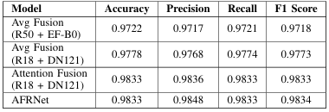
FUSION MODEL PERFORMANCE
Table 2. Performance comparison of fusion models

Slide 15
Table II shows the performance of the fusion model and compares it to the standalone model. The average accuracy of the entire fusion system was 97.22%, whereas the accuracy of the individual models used in the fusion system was higher at 98.33%. This indicates that there was an improvement in accuracy using the combination of individual baseline models. AFRNet Model performed consistently at over 98.33% across all different combinations of baseline models used to develop the fusion-based platforms, as well as achieving a greater level of precision, recall and F1 scores than the average performance of all of the standalone models. This demonstrates that using adaptive weights of the outputs from each of the individual baseline model contributes significantly to improvement in classification performance under adverse conditions.

Slide 16
CONCLUSION
This paper proposes a framework for TSR based on the LISA Dataset that includes preprocessing, several CNNs, and various types of fusion to create a high degree of accuracy and robustness. For example, using ROI extraction via bounding boxes removes background noise and improves upon the classification accuracy of CNNs. Additionally, augmentation and balancing techniques are utilized to create an equal distribution of observations across classes, leading to improved generalization through the reduction of class imbalances. The ResNet18 and EfficientNet-B0 performed best in classification accuracy when comparing individual models, while fusion further enhanced the results by providing moderate increases in accuracy through average fusion and the highest overall accuracy of 98.33% using attention-based fusion. Overall, the proposed framework combines preprocessing, Deep Learning architectures, and fusion techniques in an effective manner that produces reliable results, making the framework suitable for use in many different applications, including autonomous driving and ADAS.

Slide 17
THANK YOU

